Slide 1
Apple Foliar Disease Detector
Preserving Apple Health

Slide 2
Introduction
Setting the Stage: AFD Detector’s Introduction

Slide 3
Introduction:
Foliar diseases: Delicate whispers of nature's challenges, prompting us to nurture and protect the orchards.
Safeguarding apple orchards: Detecting foliar disease early to protect production and ensure the overall health of our apples.
Bringing technology to the orchard: We use digital image processing to analyze apple leaf images and spot foliar diseases accurately.

Slide 4
Motivation
Uncovering the Need: AFD Detector’s Importance in Apple Farming

Slide 5
Motivation:
Apple as top 5 global fruit: A leading global fruit, cultivated across vast acres of orchards.
Orchard care made tough: Manually it's hard to know which plants are sick, what diseases each leaf has, what pesticides to spray and where to spray.
Revolutionizes orchard care: Automating disease detection. Leveraging drone or satellite images.

Slide 6
Focus
Key Objectives and Scope: Defining the AFD Detector’s Role in Orchard Health

Slide 7
Focus:
Leaf Classification: Main challenge involves precisely categorizing apple leaves into six distinct disease classes. This task forms the foundation for effective orchard management, ensuring timely and targeted interventions.
Key Objectives: Maximize efficiency and save pesticides by precisely targeting affected trees and ultimately enhancing production.

Slide 8
Dataset
Data Source and Insights: Unpacking the AFD Detector’s Dataset

Slide 9
Dataset:
Plant Pathology 2021 : A competition on Kaggle. The main objective of the competition is to identify the category of foliar diseases in apple trees.
Unveiling Dataset: The dataset comprises "train.csv" with image IDs and disease labels and 18,632 images for model training and evaluation.

Slide 10
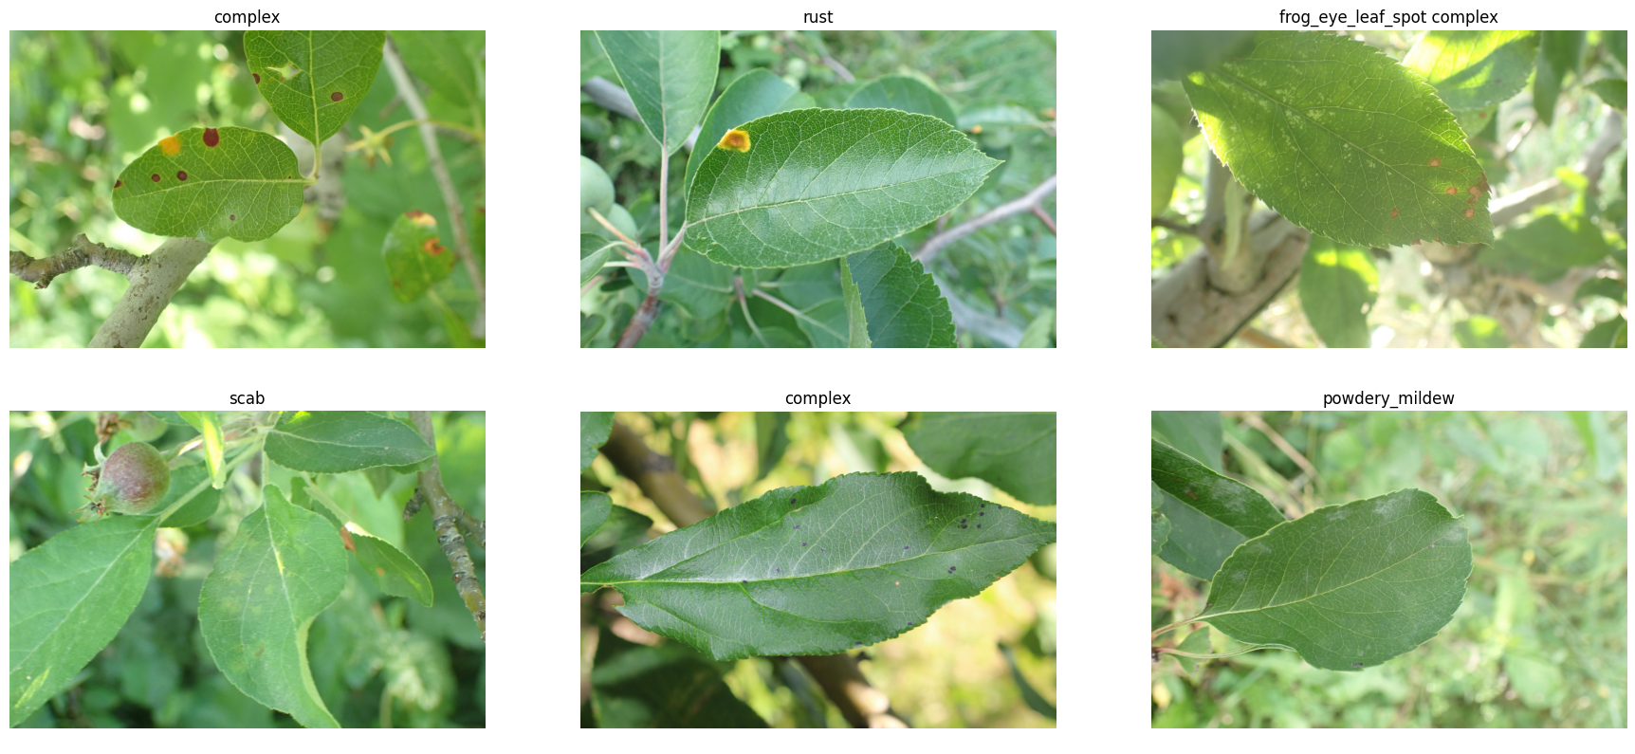
Dataset: Snapshot

Slide 11
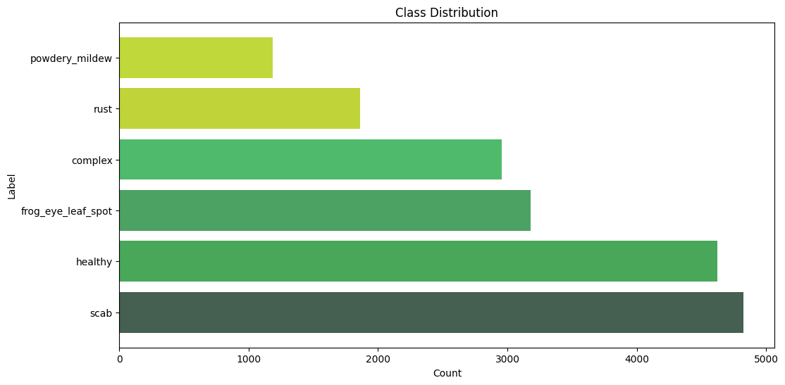
Dataset: Class Distribution

Slide 12
Preprocessing
Image Data Preparation: Preprocessing AFD Detector’s Dataset

Slide 13
Preprocessing:
Preprocessing in Image Classification: Preprocessing is a vital step in refining raw leaf images for optimal input into our classification model.
Sharpening: Enhances image clarity and feature definition by accentuating edges.
Histogram Equalization: Balances image contrast by redistributing pixel intensities.

Slide 14
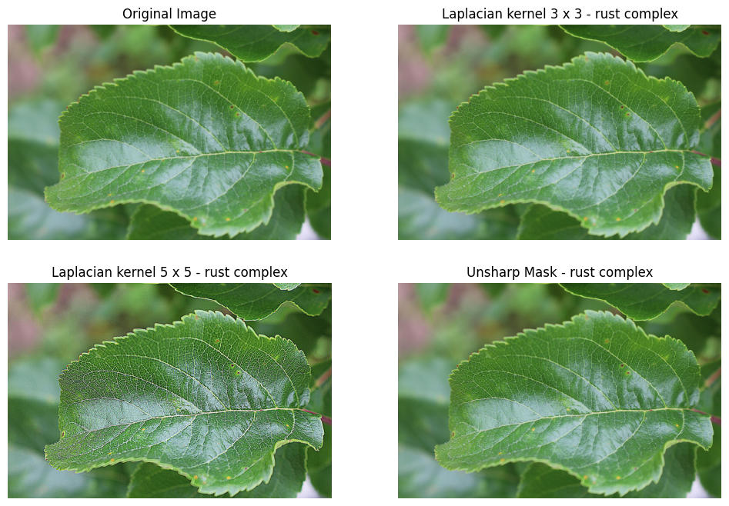
Preprocessing: Sharpening

Slide 15
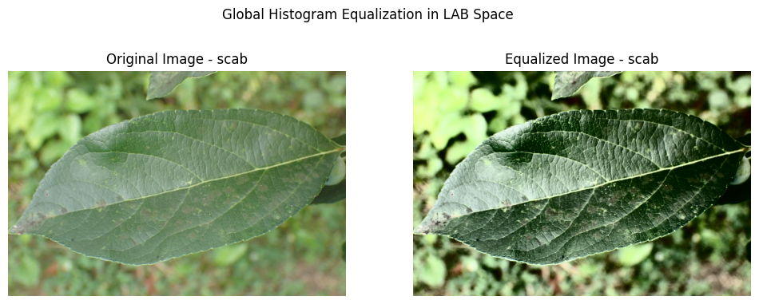
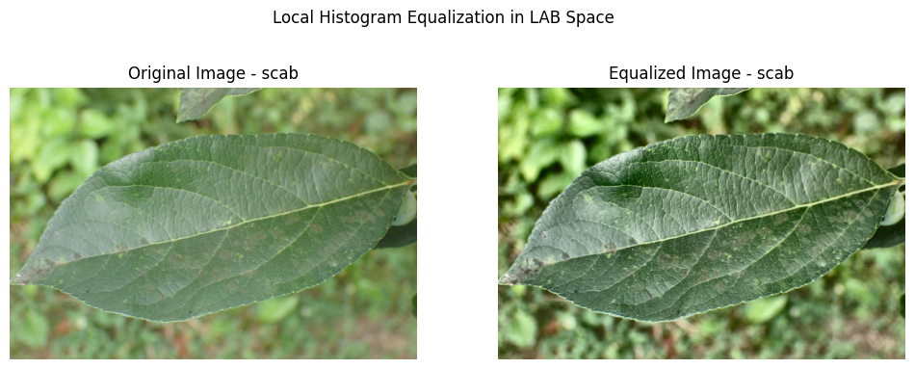
Preprocessing: Hist Equalization
Original
Global
Local

Slide 16
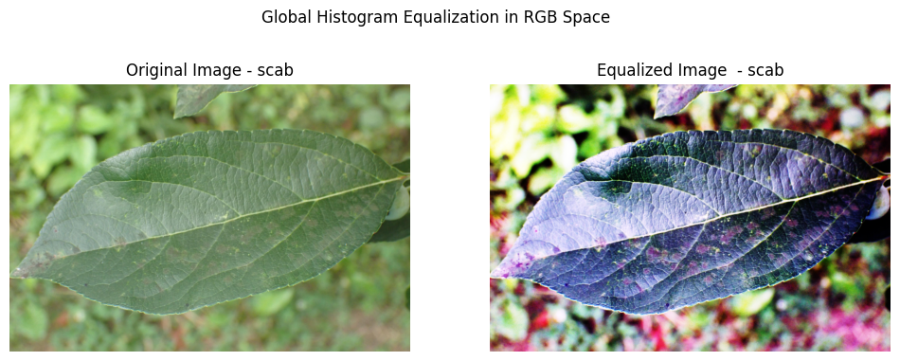
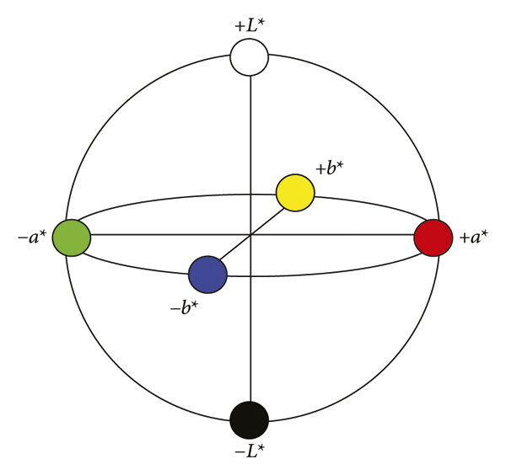
Preprocessing: RGB vs LAB

Slide 17
Models
ML Models: Choosing AFD Detector’s Learning Model for Predictions

Slide 18
Models:
Aspect | CNNs | SVMs
Type of Algorithm | Neural Network | Linear Classifier
Architecture | Deep, hierarchical | Single-layer or kernel
Feature Learning | Automated | Requires Engineering
Data Type | Often used for images | General data types
Non-linearity | Inherently nonlinear | Linear or kernel trick
Interpretability | Less interpretable | More interpretable
Scalability | Resource-intensive | Efficient for high-D data
Transfer Learning | Effective | Limited

Slide 19
CNN
Convolutional Neural Networks: AFD Detector’s Learning Model

Slide 20
CNN:
Convolutional Neural Networks: Artificial Neural network architectures designed for image and grid-like data processing, automatically extracting features and modeling complex relationships in data.
Sequential CNN: A neural network with a sequential layer arrangement, proficient at extracting intricate image features, widely employed in computer vision applications.

Slide 21
CNN: Architecture
Conv2D
(32, 3x3)
Output: 222x222x32
MaxPooling2D (2x2)
Output: 111x111x32
Conv2D
(64, 3x3)
Output: 109x109x64
MaxPooling2D (2x2)
Output: 54x54x64
Conv2D
(128, 3x3)
Output: 52x52x128
MaxPooling2D (2x2)
Output: 26x26x128
Input
224x224x3
Flatten Layer
Flatten
Output: 86528
Dense Layer
Dense (128)
Output Layer
Dense
(6 - Dense)

Slide 22
CNN: Architecture
Layer | Type | Filter/Pool | Filters/Neuron | Activation | Output Shape
Input | Input | 224x224 | - | - | 224x224x3
Conv2D | Convolutional | 3x3 | 32 | ReLU | 222x222x32
MaxPooling2D | Max Pooling | 2x2 | - | - | 111x111x32
Conv2D | Convolutional | 3x3 | 64 | ReLU | 109x109x64
MaxPooling2D | Max Pooling | 2x2 | - | - | 54x54x64
Conv2D | Convolutional | 3x3 | 128 | ReLU | 52x52x128
MaxPooling2D | Max Pooling | 2x2 | - | - | 26x26x128
Flatten | Flatten | - | - | - | 86528
Dense | Fully Connected | - | 128 | ReLU | 128
Dense | Fully Connected | - | 6 | Softmax | 6 - Output

Slide 23
Evaluation
Evaluating CNN: Analyzing AFD Detector’s Performance

Slide 24
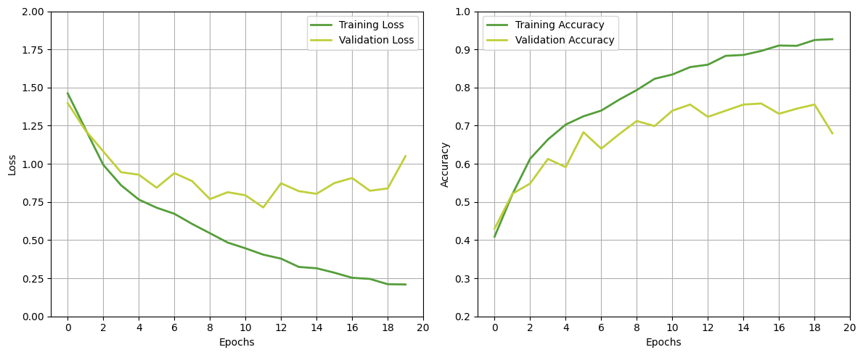
Evaluation: Loss and Accuracy

Slide 25
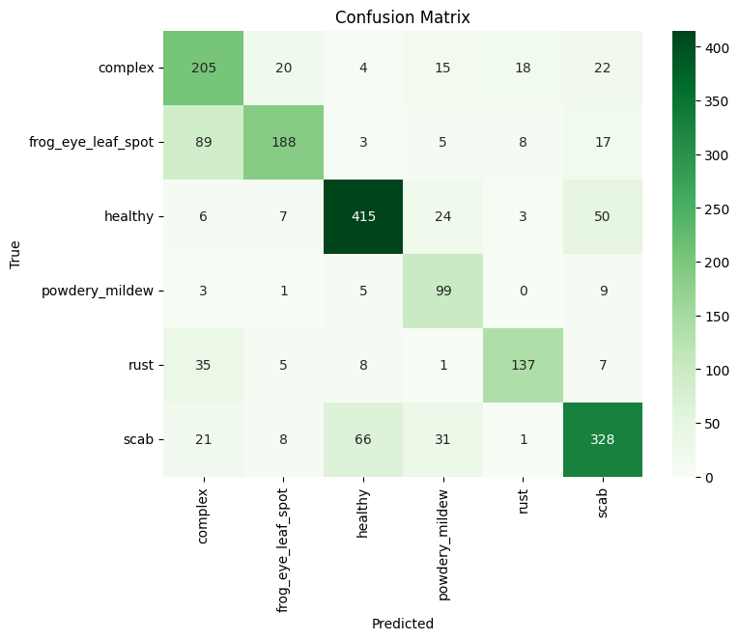
Evaluation: Confusion Matrix

Slide 26
Evaluation: Report
Class | Precision | Recall | F1-Score | Support | Correct
complex | 0.57 | 0.72 | 0.64 | 284 | 205
frog_eye_leaf_spot | 0.82 | 0.61 | 0.70 | 310 | 188
healthy | 0.83 | 0.82 | 0.83 | 505 | 418
powdery_mildew | 0.57 | 0.85 | 0.68 | 117 | 99
rust | 0.82 | 0.71 | 0.76 | 193 | 137
scab | 0.76 | 0.72 | 0.74 | 455 | 328
Accuracy |  |  | 0.74 | 1864
Macro Avg | 0.73 | 0.74 | 0.72 | 1864
Weighted Avg | 0.75 | 0.74 | 0.74 | 1864

Slide 27
Usage
Usage and Testing: AFD Detector’s Performance at Realtime Testing

Slide 28
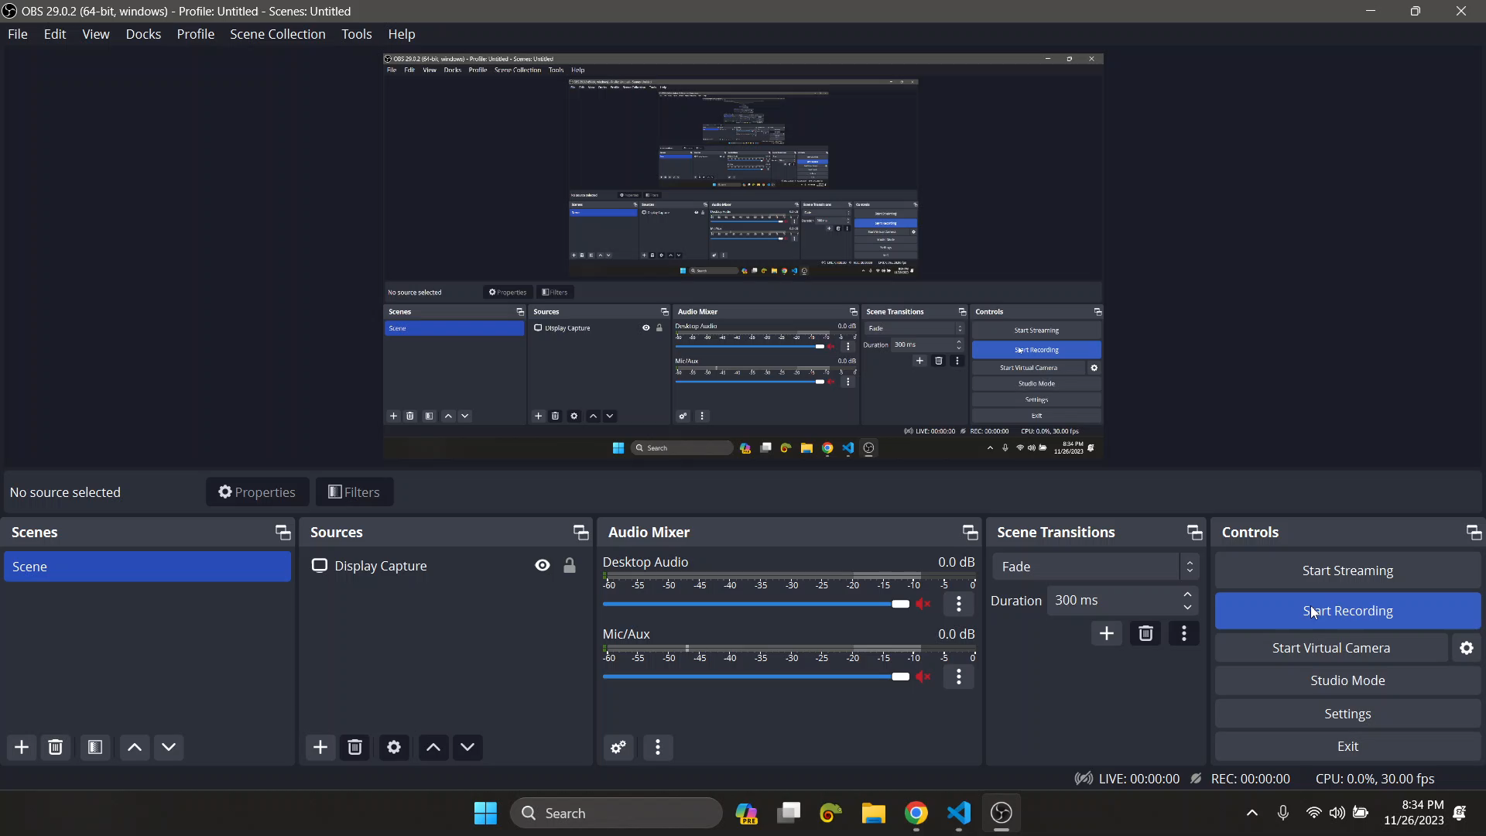
Usage: Website

Slide 29
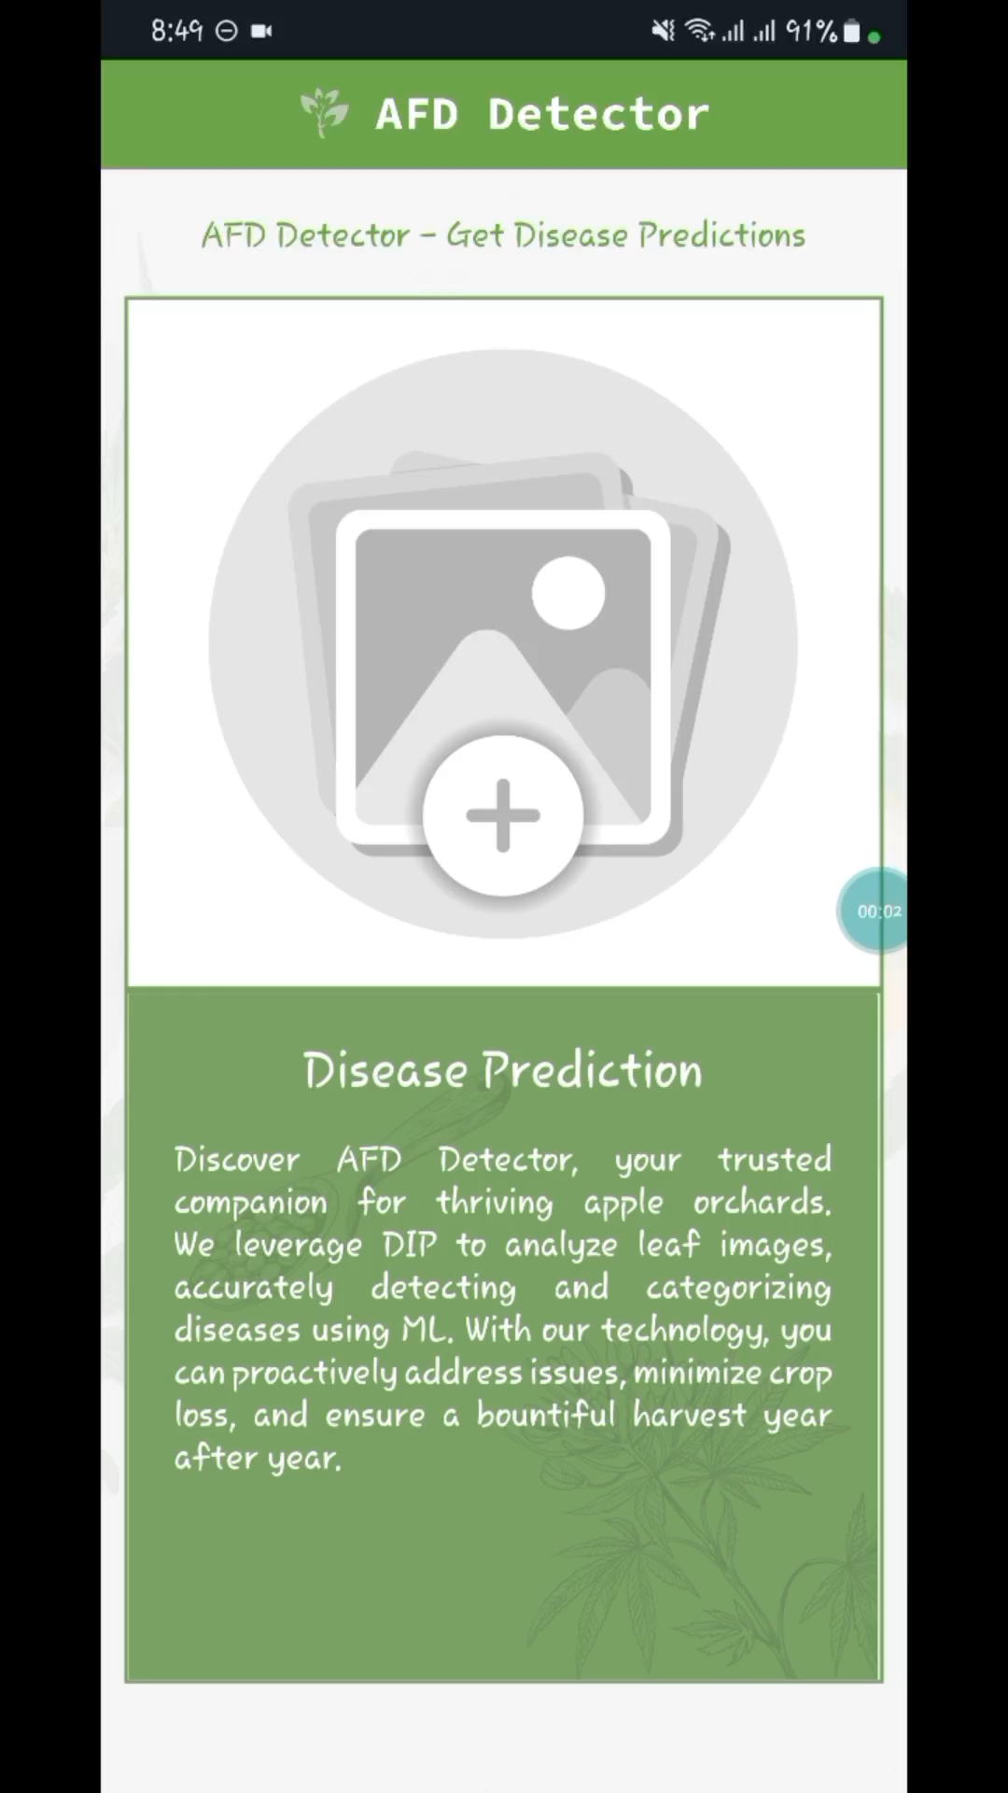
Usage: Mobile App

Slide 30
Technologies
Listing Technologies Utilized: AFD Detector’s Backbone Technologies

Slide 31
















Technologies:
DIP and ML Model:
Website:
Mobile App:

Slide 32
Conclusion
Listing Technologies Utilized: AFD Detector’s Backbone Technologies

Slide 33
Conclusion:
In conclusion: From discussing the challenges of manual care to introducing the vision of automated detection using digital image processing.
Looking ahead: Our vision is to integrate advanced detection algorithm into pesticide spraying drones or bots to spray specific pesticides only on affected trees.

Slide 34
Thank You!
I deeply appreciate your engagement during my recent presentation.

